Slide 1
L’écriture créative: faire lire et faire écrire
Christine Collière-Whiteside
Université de Bourgogne
Christine.Colliere-Whiteside@u-bourgogne.fr

Slide 2
« La compréhension serait de nature évocative et non pas perceptive. Elle dépendrait d’un geste mental de ré-expression de l’information, donnée par la perception. »
Antoine de la Garanderie,
Comprendre et imaginer, les gestes mentaux et leur mise en œuvre 1987.

Slide 3
The Wind in the Willows, Kenneth Grahame, 1908

Slide 4
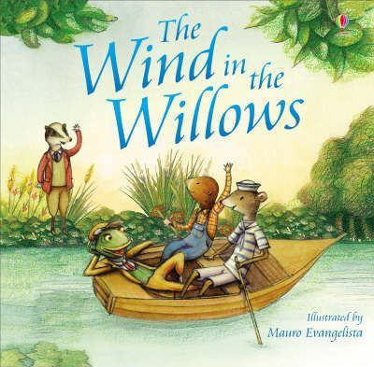
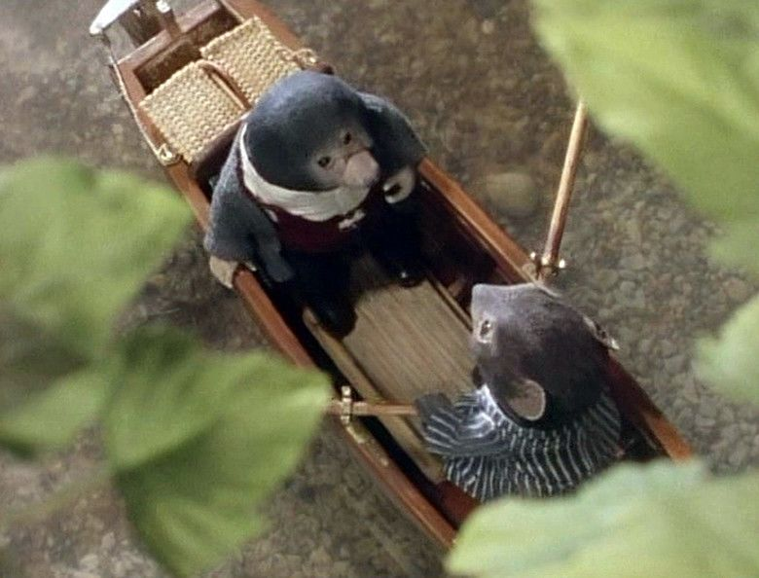
The Wind in the Willows, Mauro Evangelista et Lesley Sims (2008)
The Wind in the Willows, dir. Rosemary Anne Sisson (1983)

Slide 5
Close your eyes and listen. Write down the words that come to your mind while you listen.
Now, using those words, write a few sentences to describe what you picture in your head and what sensations you associate with this noise.
Homework : Rewrite this text at home. Try to make your description more vivid. For instance, find words that express your feelings better or work on the structure of the text. Keep all the successive versions of this text for your teacher.

Slide 6
« So he scraped and scratched and scrabbled and scrooged, and then he scrooged again and scrabbled and scratched and scraped, … »
“This sleek, sinuous, full-bodied animal, chasing and chuckling, gripping things with a gurgle and leaving them with a laugh, to fling itself on fresh playmates that shook themselves free, and were caught and held again. All was a-shake and a-shiver—glints and gleams and sparkles, rustle and swirl, chatter and bubble. »
« By the side of the river he trotted as one trots, when very small, by the side of a man who holds one spellbound by exciting stories; and when tired at last, he sat on the bank, while the river still chattered on to him, a babbling procession of the best stories in the world, sent from the heart of the earth to be told at last to the insatiable sea. »
The Wind in the Willows, Chap 1

Slide 7
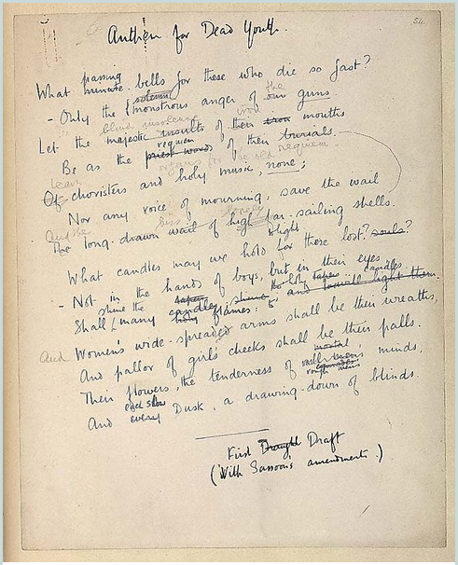
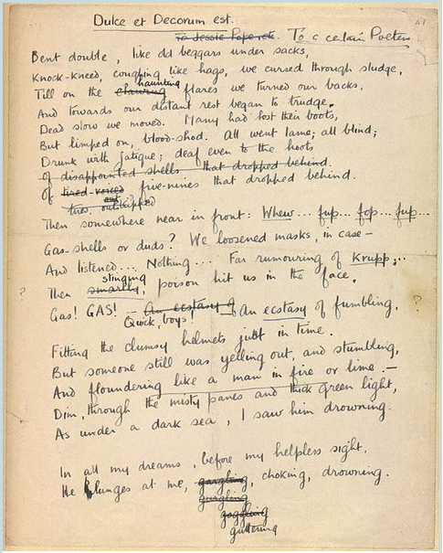
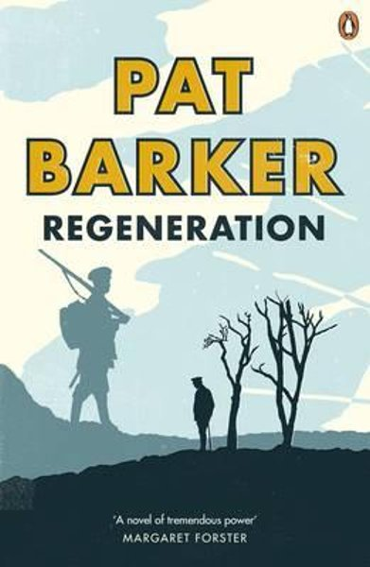
Click on the pictures for more
Notes:
http://ww1lit.nsms.ox.ac.uk/ww1lit/collections
http://ww1lit.nsms.ox.ac.uk/ww1lit/collections/item/4647
http://ww1lit.nsms.ox.ac.uk/ww1lit/collections/document/5215/4631

Slide 8
Click on the picture to get to the online manuscript
Notes:
https://www.bl.uk/collection-items/corrected-typescript-of-the-importance-of-being-earnest-by-oscar-wilde et
https://www.bl.uk/works/the-importance-of-being-earnest

Slide 9
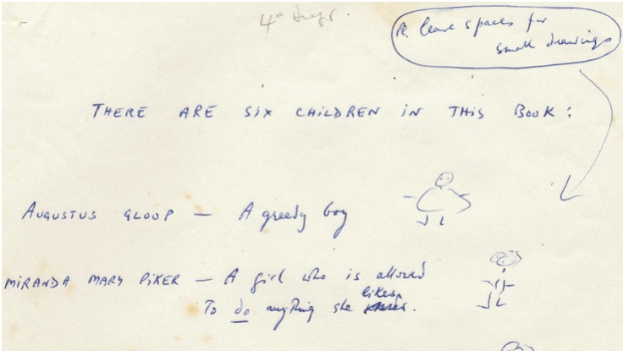
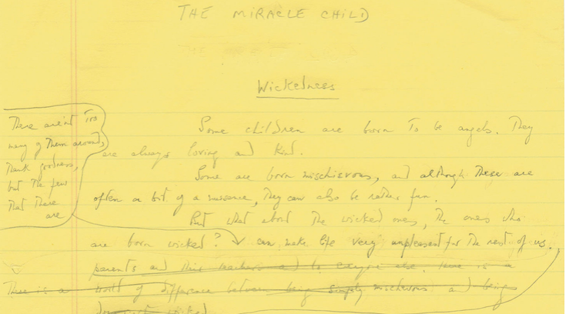
Click on the pictures to get to the online manuscript

Slide 10
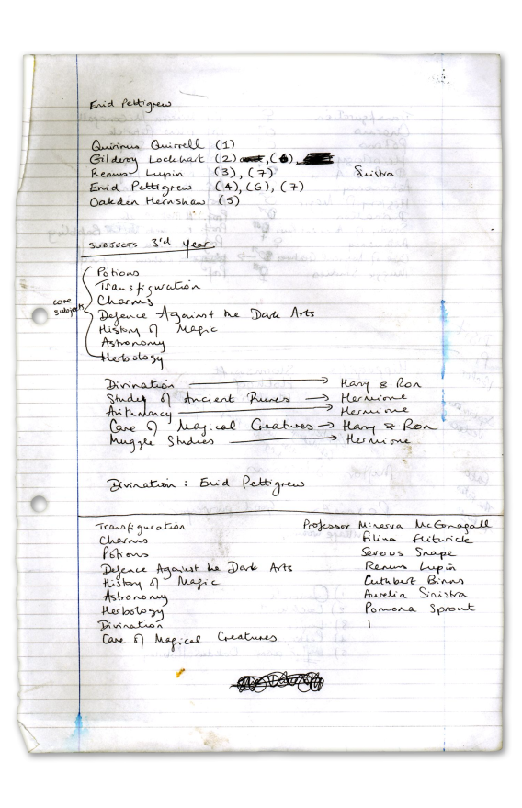
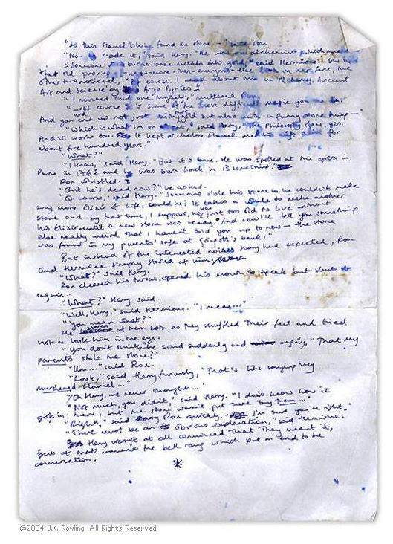
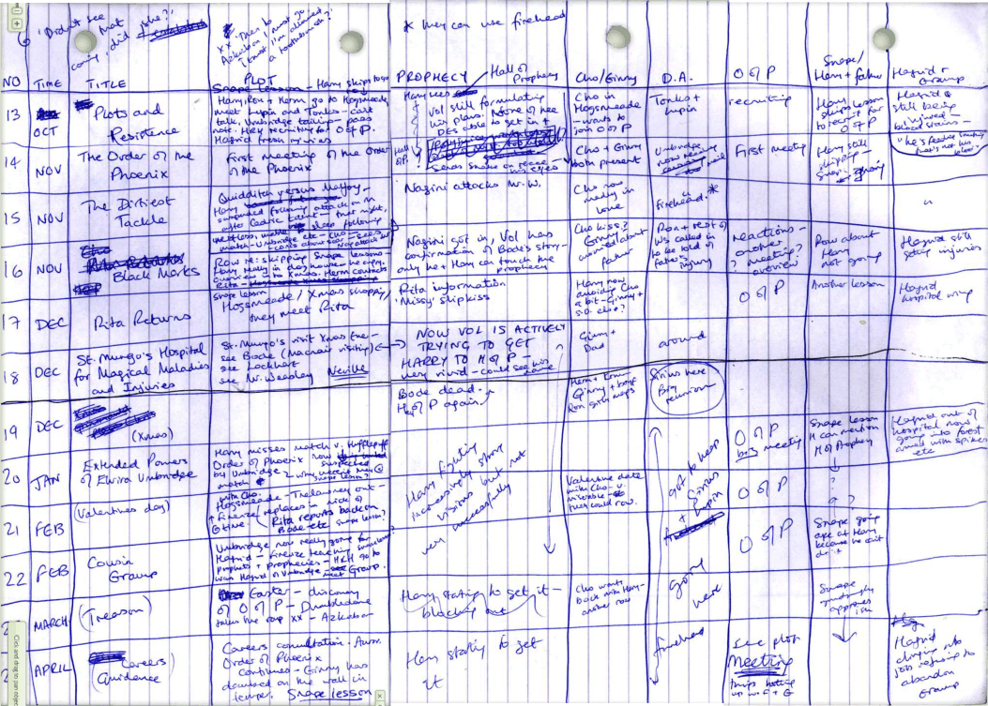
Click on the pictures to get to the online manuscript

Slide 11
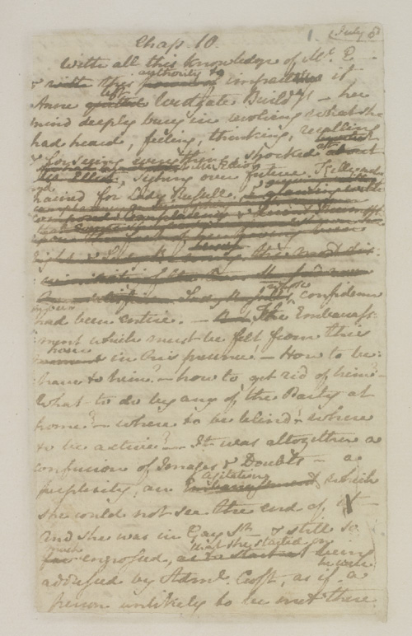
Click on the pictures to get to the online manuscript
Persuasion, chap 10
British Library,
MS Egerton 3038

Slide 12
Bibliographie
Barker, Pat, Regeneration, London: Viking Press, 1991.
Damasio Antonio R. (2010). L’autre moi-même : les nouvelles cartes du cerveau, de la conscience et des émotions, Paris : Odile Jacob.
The Harry Potter Lexicon, page rassemblant les avant-textes publiés sur JKRowling.com, https://www.hp-lexicon.org/source/other-canon/jkr/jkr-com-scrapbook/
The Jane Austen’s Fiction Manuscripts Digital Edition, https://janeausten.ac.uk/index.html (manuscrits et transcription)
La Garanderie, Antoine de, Comprendre et imaginer, les gestes mentaux et leur mise en œuvre, Paris : Le Centurion, 1987.
MacKinnon, Gillies (dir.), Regeneration, 1997.
Owen, Wilfred, “Dulce et Decorum Est,”, manuscrits successifs en ligne sur First World War Poetry Digital Archive, http://ww1lit.nsms.ox.ac.uk/ww1lit/items/show/8175.
The Roald Dahl Museum and Story Centre, https://www.roalddahl.com/home/teachers
Wilde Oscar, tapuscrit de The Importance of Being Earnest, portant des révisions autographes, https://www.bl.uk/collection-items/corrected-typescript-of-the-importance-of-being-earnest-by-oscar-wilde ou http://www.bl.uk/manuscripts/FullDisplay.aspx?ref=Add_MS_81624, 1894, British Library.
Wilde Oscar, manuscrit de The Importance of Being Earnest, https://www.bl.uk/collection-items/manuscript-draft-of-the-importance-of-being-earnest-by-oscar-wilde#, c. 1894.

