Slide 1
L’IMAGE FIXE
Sophie Aymes
sophie.aymes@bourgogne.fr

Slide 2
Utiliser des illustrations
Contre la conception ancillaire de l’illustration
Le goût de lire
L’analyse d’image
La relation esthétique à l’image

Slide 3
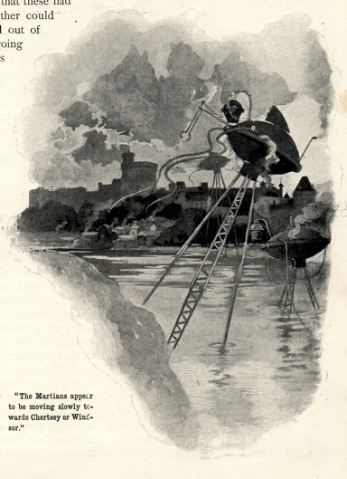
H.G. Wells, The War of the Worlds (1897, 1898)
Adaptations
http://www.impossiblefactual.com
Warwick Goble: Pearson’s Magazine
(Londres, 1897)
Procédés photomécaniques

Slide 4
And this Thing I saw! How can I describe it? A monstrous tripod, higher than many houses, striding over the young pine trees, and smashing them aside in its career; a walking engine of glittering metal, striding now across the heather; articulate ropes of steel dangling from it, and the clattering tumult of its passage mingling with the riot of the thunder. A flash, and it came out vividly, heeling over one way with two feet in the air, to vanish and reappear almost instantly as it seemed, with the next flash, a hundred yards nearer. Can you imagine a milking stool tilted and bowled violently along the ground? That was the impression those instant flashes gave. But instead of a milking stool imagine it a great body of machinery on a tripod stand.
Then suddenly the trees in the pine wood ahead of me were parted, as brittle reeds are parted by a man thrusting through them; they were snapped off and driven headlong, and a second huge tripod appeared, rushing, as it seemed, headlong towards me. And I was galloping hard to meet it! At the sight of the second monster my nerve went altogether. Not stopping to look again, I wrenched the horse’s head hard round to the right and in another moment the dog cart had heeled over upon the horse; the shafts smashed noisily, and I was flung sideways and fell heavily into a shallow pool of water.
H.G. Wells, The War of the Worlds (1898, book I, chapter X). Gutenberg.org

Slide 5
Warwick Goble Robert Seymour (Book II , chapter X) The March of Intellect (1828)

Slide 6
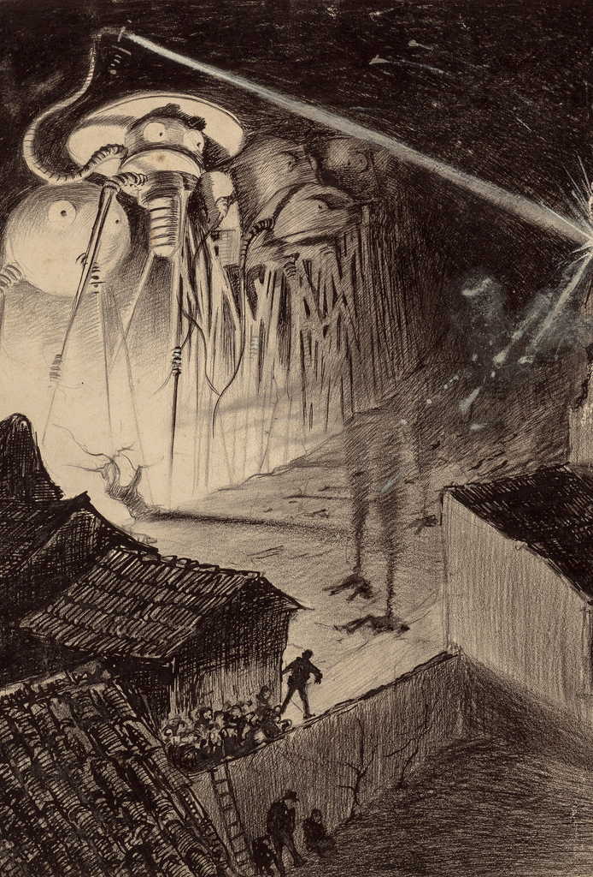
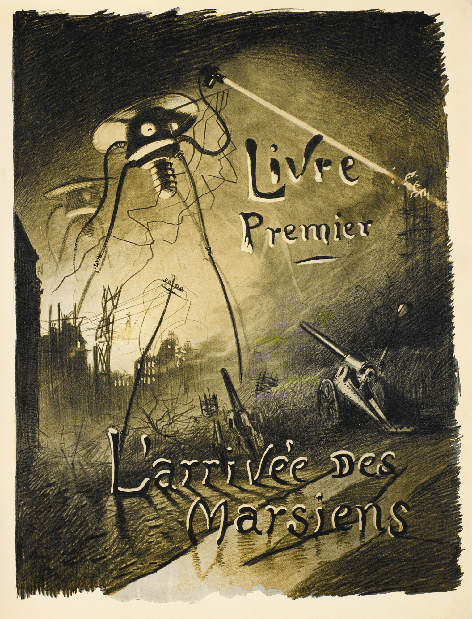
Henrique Alvim Corrêa (L. Vandamme, 1906)

Slide 7
Le dossier personnel de l’élève
Diachronie
Conventions
Synchronie
Pour le dossier personnel de l’élève

Slide 8
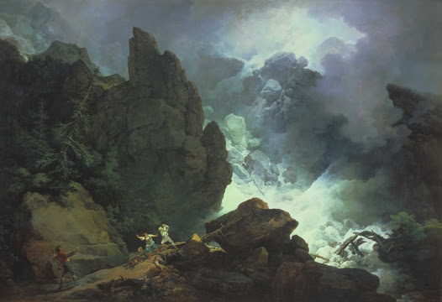
Philip de Loutherbourg An Avalanche in the Alps (1803) oil on canvas, 109.9 x 160 cm

Slide 9
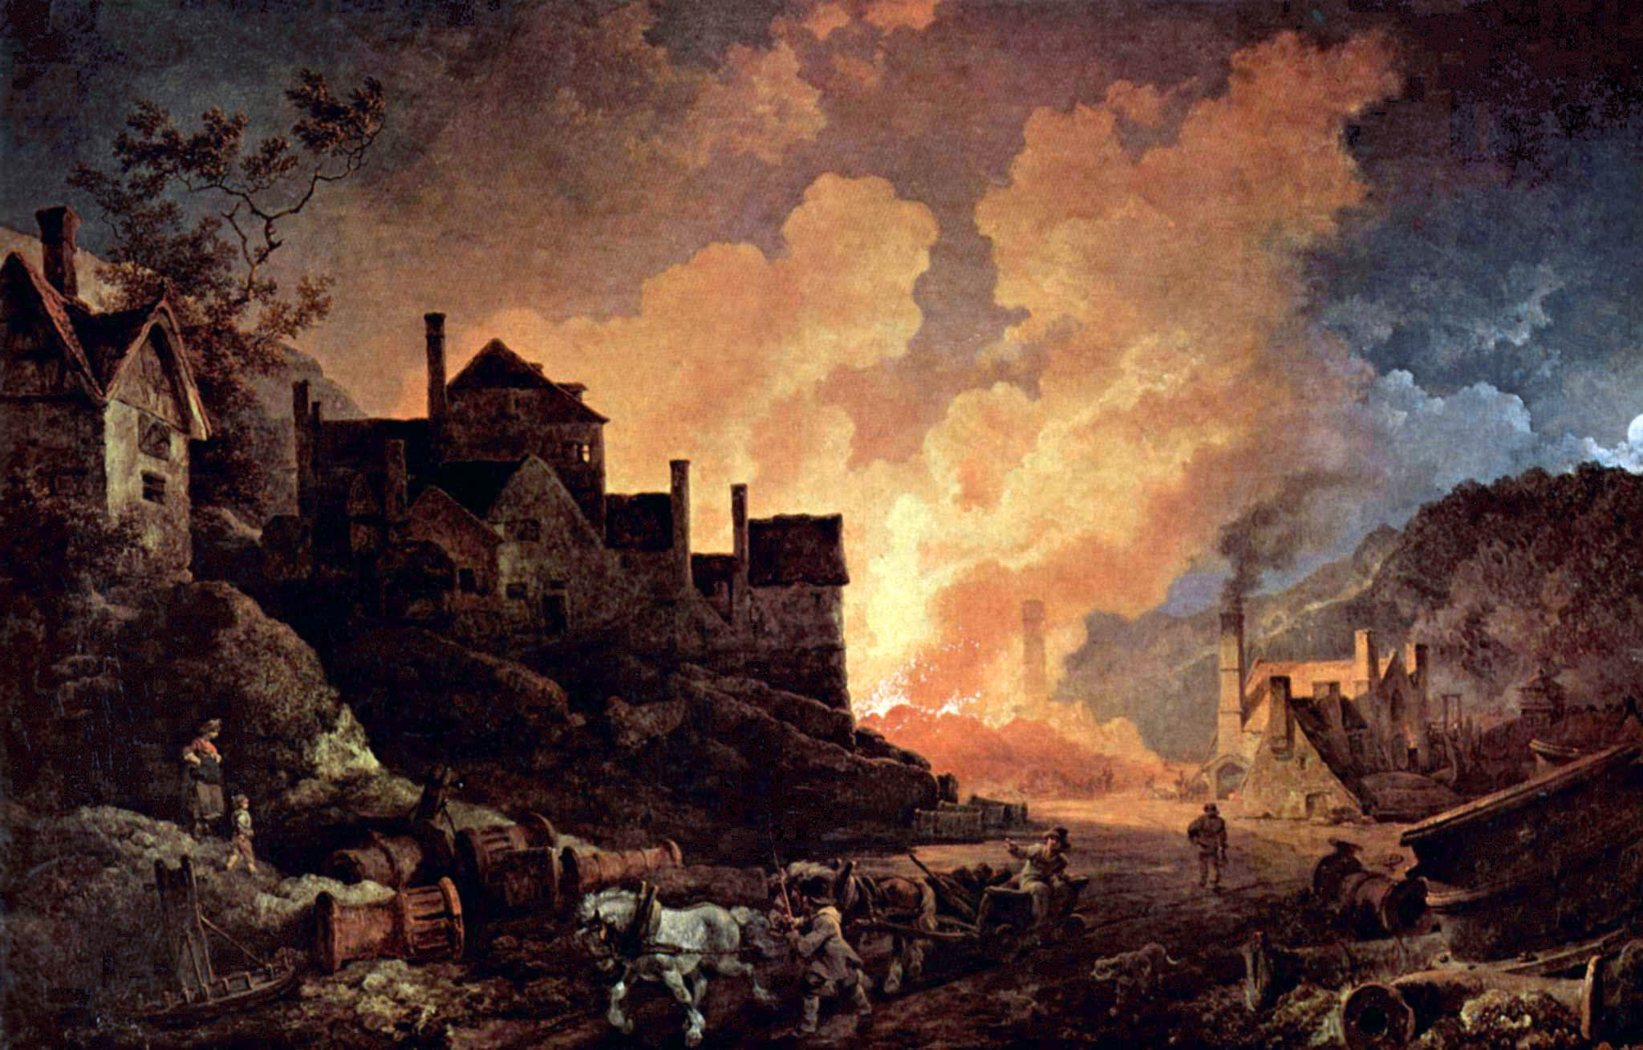
Philip de Loutherbourg Coalbrookdale by Night (1801) oil on canvas, 67.9 x 106.7 cm

Slide 10
John Martin The Great Day of His Wrath (1852) oil on canvas, 197 cm × 303 cm

Slide 11
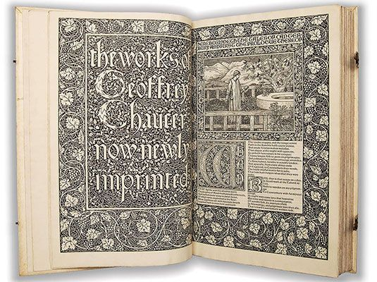
Prologue to The Canterbury Tales by Geoffrey Chaucer Kelmscott Press, London, 1896. (William Morris & Edward Burne-Jones) https://www.bl.uk/collection-items/the-kelmscott-chaucer

Slide 12
William Morris, News from Nowhere (1890, 1892)

Slide 13
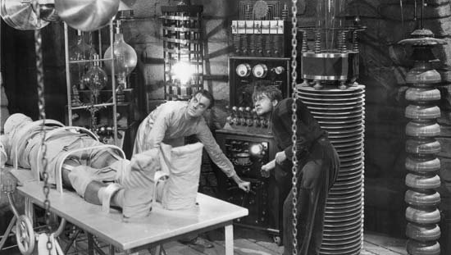
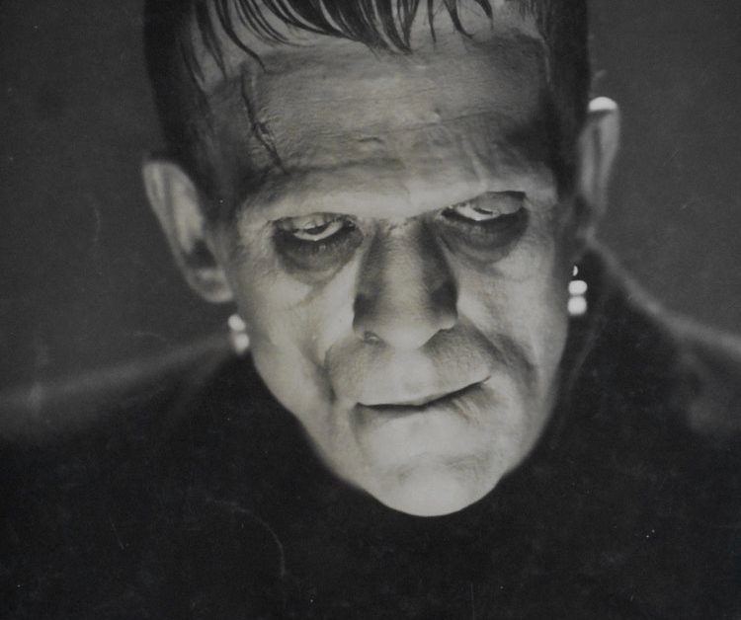
L’illustration subversive
Theodor Von Holst’s frontispiece (1831) James Whale (1931)
Mary Shelley, Frankenstein; Or, the Modern Prometheus (1818)
https://romanticillustrationnetwork.com/2016/11/26/image-of-the-month-theodore-von-holst-frankenstein-1831/

Slide 14
(chapitre 5)
It was on a dreary night of November that I beheld the accomplishment of my toils. With an anxiety that almost amounted to agony, I collected the instruments of life around me, that I might infuse a spark of being into the lifeless thing that lay at my feet. It was already one in the morning; the rain pattered dismally against the panes, and my candle was nearly burnt out, when, by the glimmer of the half-extinguished light, I saw the dull yellow eye of the creature open; it breathed hard, and a convulsive motion agitated its limbs.

Slide 15
L’edition Moxon des poèmes de Alfred, Lord Tennyson(1857) “The Lady of Shalott” (1832) Illustration de William Holman Hunt
She left the web, she left the loom
She made three paces thro’ the room
She saw the water-flower bloom,
She saw the helmet and the plume,
She look’d down to Camelot.
Out flew the web and floated wide;
The mirror crack’d from side to side;
‘The curse is come upon me,’ cried
The Lady of Shalott.
(“The Lady of Shalott”, Part III, st. 5)

Slide 16
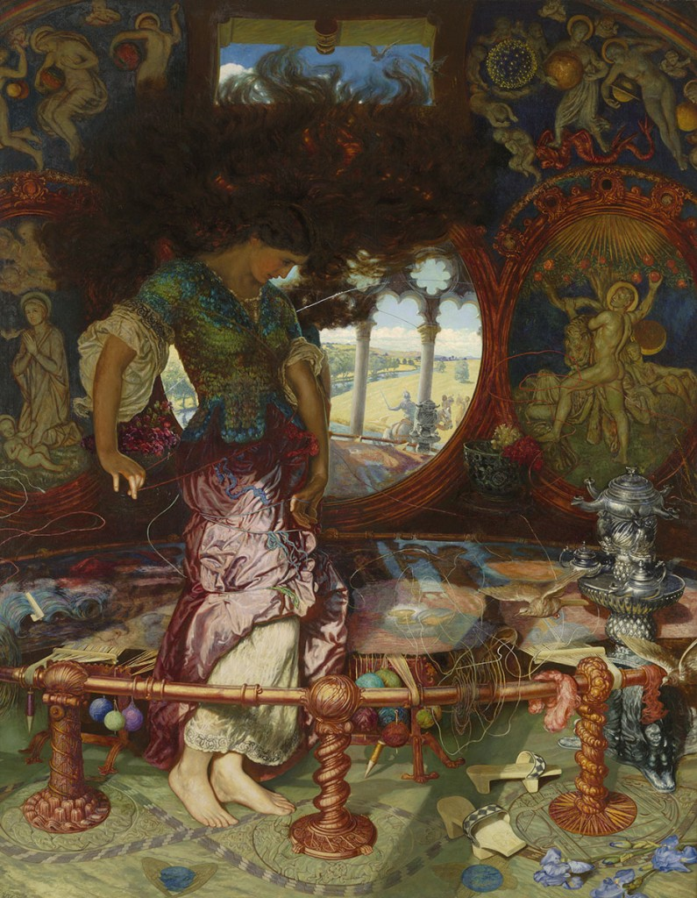
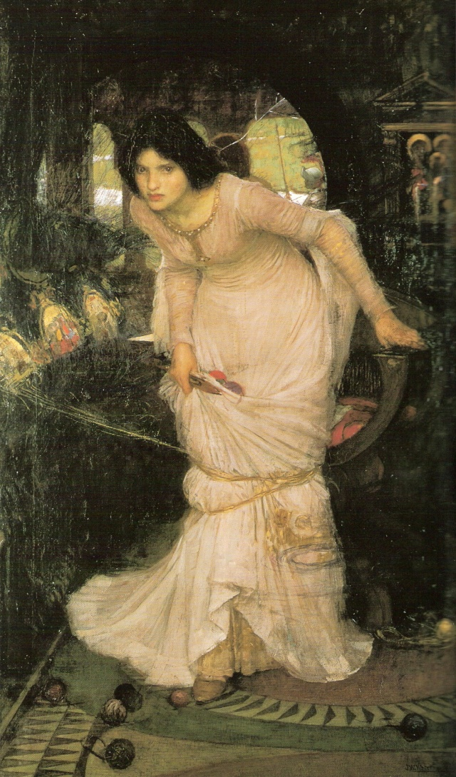
Topos pré-raphaélite : ‘the embowered woman’
William Holman Hunt
The Lady of Shalott (1890-1905)
John William Waterhouse
The Lady of Shalott (1894)

Slide 17
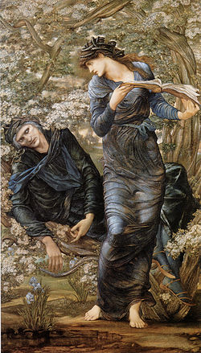
Sir Edward Burne-Jones The Beguiling of Merlin (1874) huile sur toile, 186 x 111 cm.
From Thomas Malory’s
Le Morte D’Arthur (1470)

Slide 18
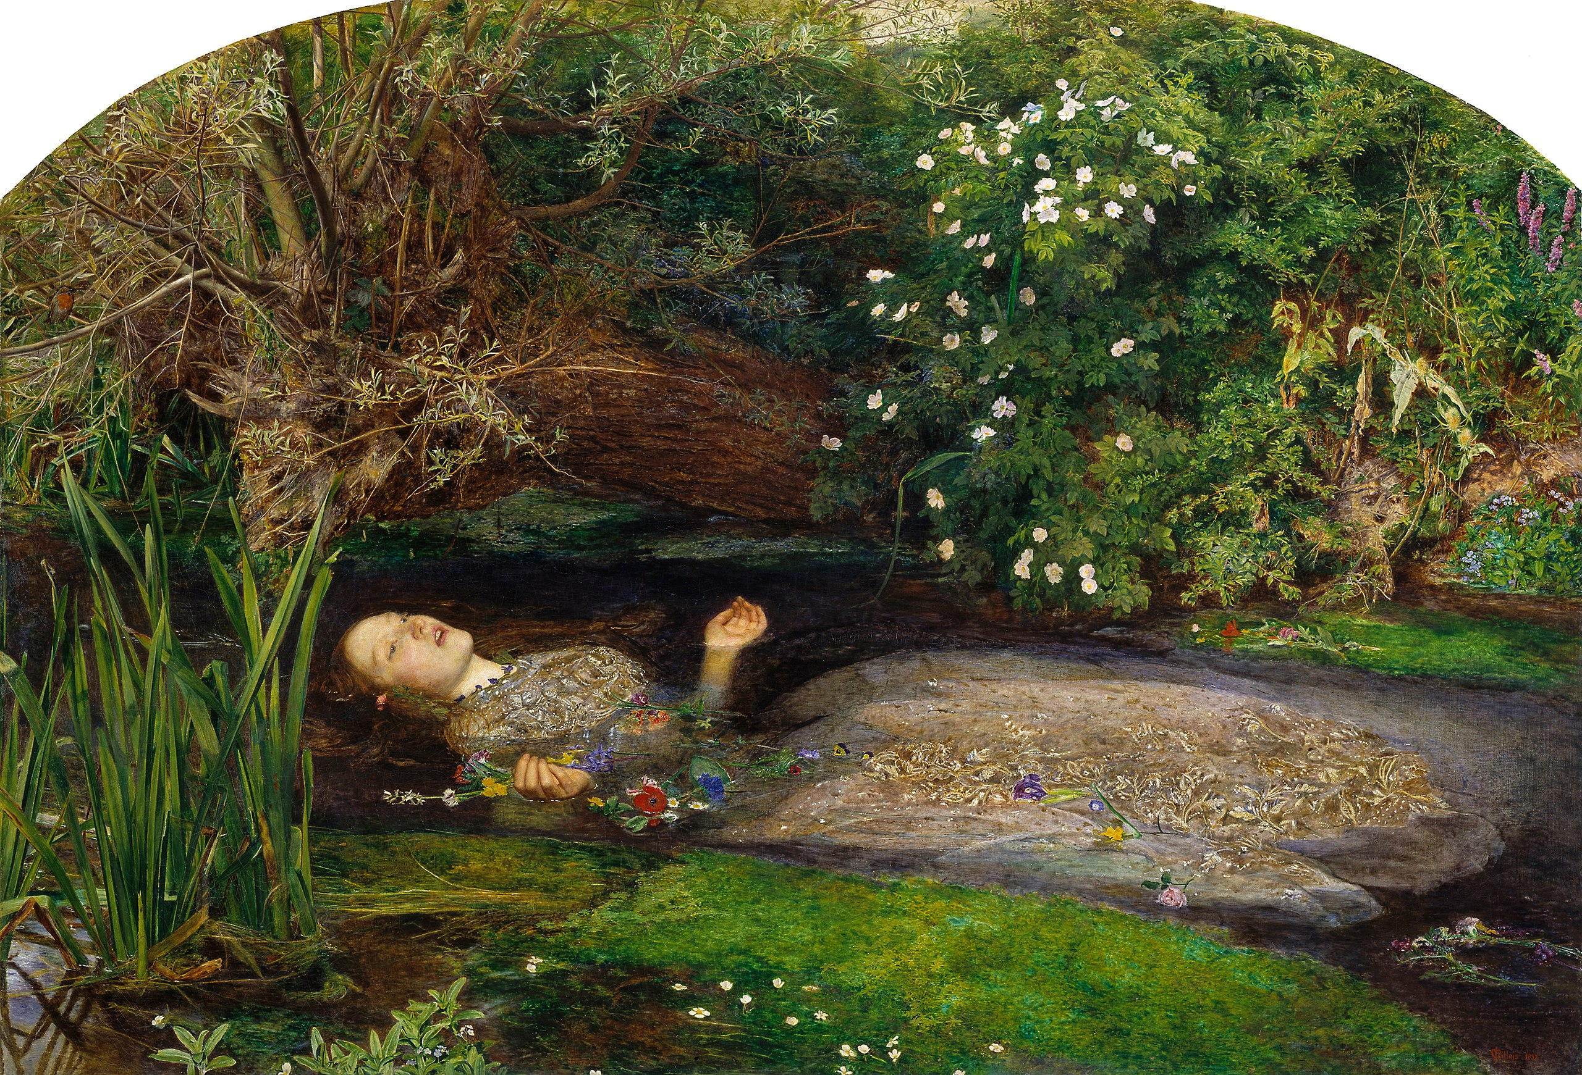
Sir John Everett Millais, Ophelia (1851-1852) huile sur toile, 76,20 x 111,80 cm

Slide 19
La migration des images
hiérarchie : culture savante et populaire
hybridité et appropriations
Intermédialité et transmédialité
L’élève comme illustrateur ; l’écriture créative

Slide 20
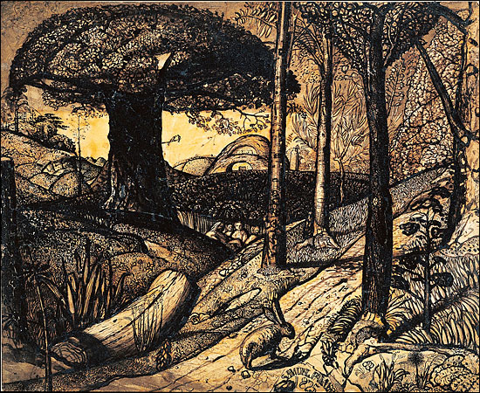
Pastorale et élégie Samuel Palmer Early Morning (1825)
The trees were the worst loss and damage, for at Sharkey’s bidding they had been cut down recklessly far and wide over the Shire; and Sam grieved over this more than anything else. For one thing, this hurt would take long to heal, and only his great-grandchildren, he thought, would see the Shire as it ought to be.
Then suddenly one day, for he had been too busy for weeks to give a thought to his adventures, he remembered the gift of Galadriel. He brought the box out and showed it to the other Travellers (for so they were now called by everyone), and asked their advice.
‘I wondered when you would think of it,’ said Frodo. ‘Open it!’
J.R.R. Tolkien, The Lord of the Rings. The Return of the King (1955)

Slide 21
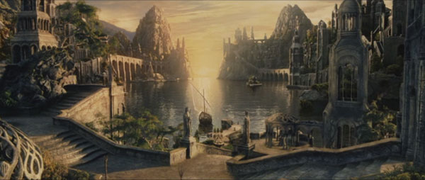
Peter Jackson, The Return of the King (2003): the Grey Havens

Slide 22
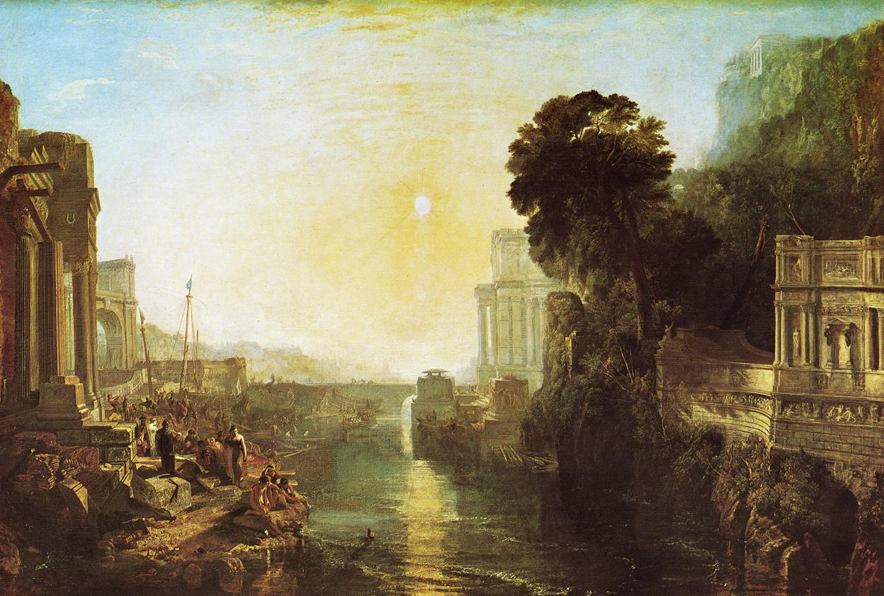
William Turner, Dido building Carthage; or the Rise of the Carthaginian Empire (1815) huile sur toile, 155,5 x 230 cm, , National Gallery

Slide 23
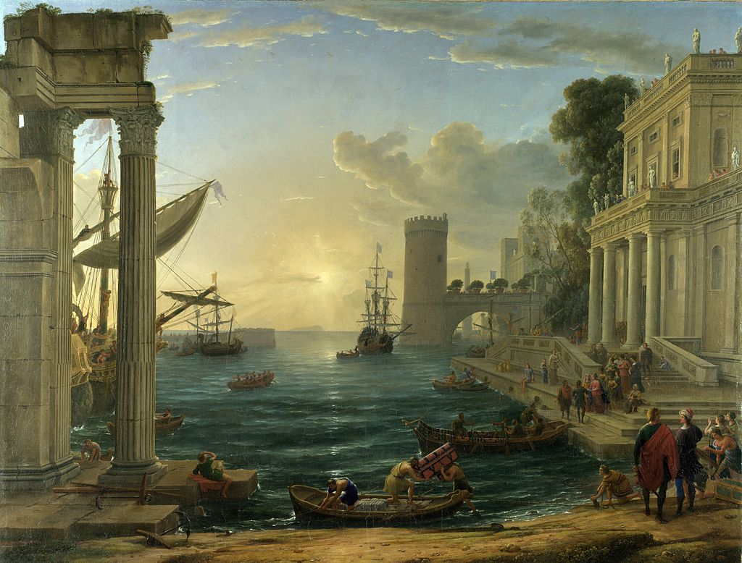
Claude Lorrain Seaport with the Embarkation of the Queen of Sheba (1648) huile sur toile, 149,1 x 196,7 cm, National Gallery

Slide 24
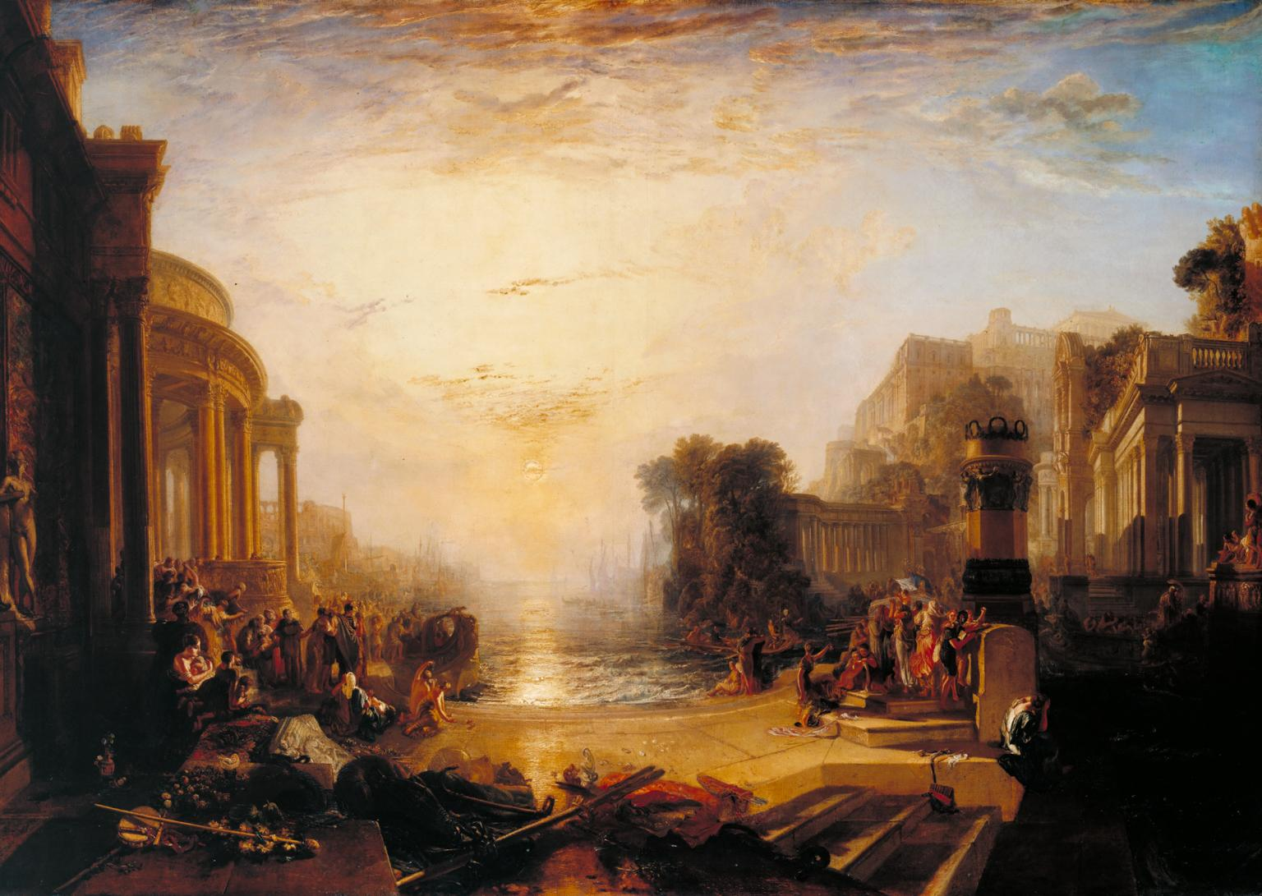
William Turner The Decline of the Carthaginian Empire (1817) huile sur toile, 170 x 238 cm

Slide 25
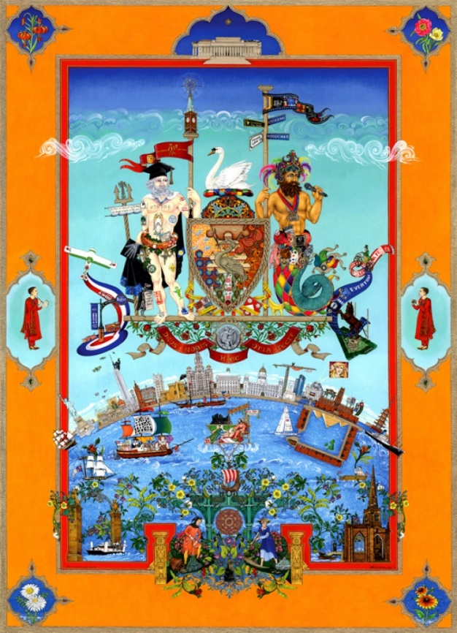
Amrit & Rabindra K.D. Kaur Singh, Liverpool 800: The Changing Face of Liverpool (2007) Poster, 54,6 x 81,3cm

Slide 26
Quelques références
British Library: https://www.bl.uk/romantics-and-victorians/articles/victorian-utopias
https://www.bl.uk/romantics-and-victorians/videos/the-gothic
British Museum: https://www.britishmuseum.org/
https://www.britishmuseum.org/visiting/planning_your_visit/audio_guides.aspx?lang=en
Folio Society: https://www.foliosociety.com/
Metropolitan Museum: https://www.metmuseum.org/toah/
National Museum of Ireland: https://www.museum.ie/Home
Tate : https://www.tate.org.uk/art/art-terms

Slide 27
ACTON, Mary. Learning to Look at Paintings, London, Routledge, 1997.
—. Learning to look at Modern Art, London, Routledge, 2004.
—. Learning to look at Sculpture, London, Routledge, 2014.
BRUCKMULLER-GENLOT, Danielle. Peinture et civilisation britanniques : culture et représentation, Gap, Ophrys, 1999.
GADOUIN, Isabelle. Le commentaire de documents iconographiques à l’épreuve orale de synthèse, Paris, Éditions du temps, 2001.
GRELLET, Françoise. Crossing Boundaries: Histoire et culture des pays du monde anglophone, Rennes, Presses Universitaires de Rennes, 2012.
LAURENT, Béatrice La peinture anglaise : histoire et méthodologie par l'analyse de tableaux du XVIIIe siècle au XXe siècle, Nantes, Éd. du temps, 2006.
MANGHANI, Sunil. Image Studies: Theory and Practice, London, Routledge, 2012.

Slide 28
MCGREGOR, Neil. Making Masterpieces, London, BBC Education / National Gallery Publications, 1997.
ROSE, Gillian. Visual Methodologies: An Introduction to the Interpretation of Visual Materials, London, Sage, 2006.
THILEMANS, Veerle & WASCHEK, Matthias, L'art américain : Identités d'une nation, Giverny ; Musée du Louvre ; École nationale supérieure des beaux-arts, 2005.
VALENTIN, Marie-Hélène. Le Monde anglophone, Paris : Hachette Supérieur (Grands repères culturels), 2005.

